Slide 1
Operating System Principle
Lab 2
March 15, 2021

Slide 2
Outline
C Programming
make and Makefile
Linux Kernel Module

Slide 3
C Compiler: GCC
Installation
  sudo apt-get update
  sudo apt-get install gcc
gcc
  gcc *.c
  gcc -c *.c: output .o （object file）
  gcc -o <output-name> *.c: name output （executable file）
  gcc -o <output-name> *.o:
Notes:
https://www.gnu.org/manual/

Slide 4
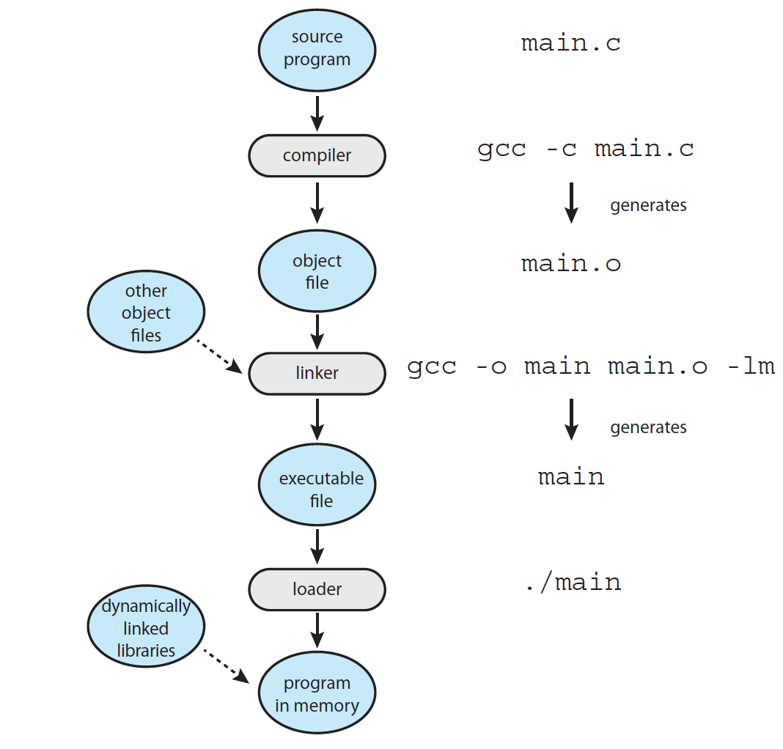
Compile, Link, Load, and Run
demo

Slide 5
Multiple Source Files
E.g.
  Mysum
  gcc main.c
  gcc mysum.c
  gcc -c main.c
  gcc -c mysum.c
  gcc -c main.c mysum.c
  gcc main.o mysum.o
mysum.h
main.c
mysum.c

Slide 6
Task 1

Slide 7
Makefile

Slide 8
make
make
  A utility to maintain a group of programs
sudo apt-get install make
Notes:
https://www.gnu.org/software/make/

Slide 9
Makefile and make
A series of rules
  What is a rule?
Target: prerequisites （dependancies）
[TAB] command
demo
Notes:
https://www3.ntu.edu.sg/home/ehchua/programming/cpp/gcc_make.html

Slide 10
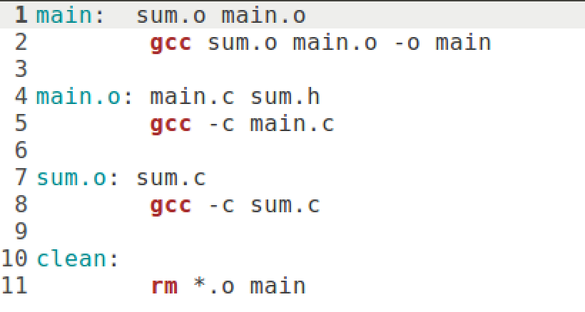
Makefile
Phoney target

Slide 11
Note
Makefile vs. makefile
  Both are OK; no file extension
Tab
Notes:
If the command is not preceded by a tab, you get an error message "makefile:4: *** missing separator. Stop."
If there is no makefile in the current directory, you get an error message "make: *** No targets specified and no makefile found. Stop."
The makefile can be named "makefile", "Makefile" or "GNUMakefile", without file extension.

Slide 12
Task 2

Slide 13
Linux Kernel Module

Slide 14
Linux Kernel Module
Loadable Kernel Module (LKM) is an object file that contains code to extend the running kernel, or so-called base kernel, of an operating system. LKMs are typically used to add support for new hardware (as device drivers) and/or file systems, or for adding system calls. When the functionality provided by a LKM is no longer required, it can be unloaded in order to free memory and other resources. (https://en.wikipedia.org/wiki/Loadable_kernel_module)
It is important for you to keep in mind that you are indeed writing kernel code that directly interacts with the kernel. That normally means that any errors in the code could crash the system!

Slide 15
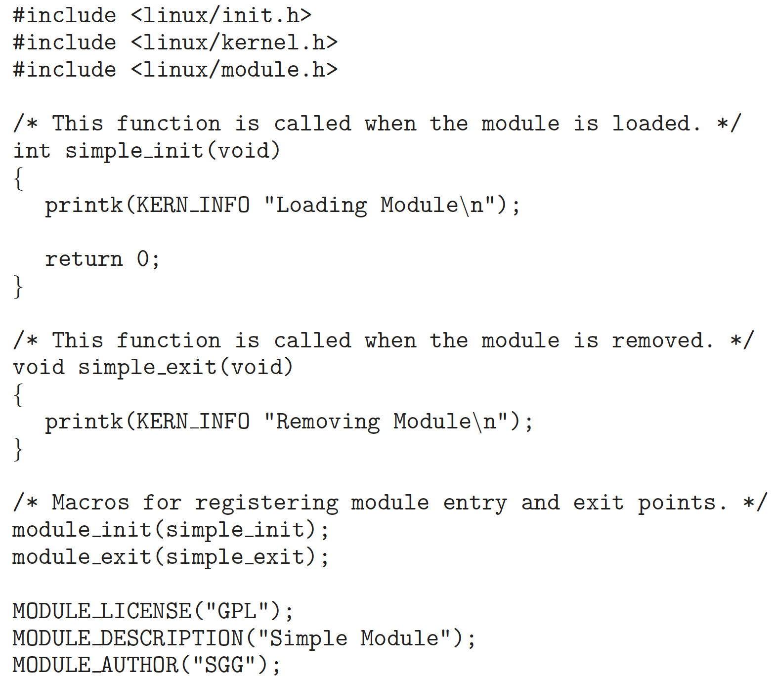
Kernel Module Structure
Head files
Function called when module is loaded
Function called when module is removed
Module registration
License, description, author
Notes:
https://tldp.org/LDP/lkmpg/2.6/html/
https://linux-kernel-labs.github.io/refs/heads/master/labs/kernel_modules.html

Slide 16
Compile Kernel Module
obj-m += <filename>.o
  Output <filename>.ko （the same name as the <filename>.c source file）
all:
  make -C /lib/modules/$(shell uname -r)/build M=$(shell pwd) modules
clean:
  make -C /lib/modules/$(shell uname -r)/build M=$(shell pwd) clean
Notes:
-C 进入到内核的目录执行Makefile ，M=$(PWD)表示返回当前目录，再次执行Makefile，modules 编译成模块的意思

Slide 17
List, Show,Load & Remove Modules
file *.ko
modinfo *.ko
lsmod
sudo insmod *.ko
sudo rmmod *
head -n
tail -n
pipe: |

Slide 18
Kernel Message
printk(KERN INFO "*******");
  KERN INFO: priority of this message
dmesg: display
sudo dmesg -c: clean

Slide 19
Useful Commands
head
  head -n
tail
  tail -n
Linux pipe
  |
Notes:
grep “***”

Slide 20
Task 3
Values and functions available only in the kernel
  jiffies: number of timer interrupts since the system boot
  HZ: the timer interrupt frequency
jiffies and HZ are two variables defined in the kernel
  jiffies: unsigned long int
  HZ: int

Slide 21
The End

